Slide 1
Git & Github Tutorial
By David Condroski

Slide 2
Creating a Github Account
Notes:
Have slides of step by step instructions with pictures with the last few slides being a summary of the process to make it easier to remember

Slide 3
Navigate to https://github.com/pricing
For more information on the tiers, see: https://github.blog/2022-06-01-github-team-or-free-how-to-choose-the-right-plan/#:~:text=Erdem%3A%20The%20Free%20plan%20automatically,%2C%20as%20an%20add%2Don.
This tutorial will cover using the free plan
Click Join for free and create the account

Slide 4
Getting Git Installed

Slide 5
Mac
Check to see if git is already installed by
Opening Bash
And typing `git version`
Hit enter
You will see if git is installed already or not
If not, then go to the link below which should download the installer automatically
https://sourceforge.net/projects/git-osx-installer/files/git-2.23.0-intel-universal-mavericks.dmg/download?use_mirror=autoselect
(Homebrew can also be used to install git if that is already installed)

Slide 6
Windows
Type `git version` in the command line
If not installed, then go to https://gitforwindows.org/ and install
Alternatively, you can install Windows Subsystem for Linux and install using the Linux method
To install WSL, in powershell, run `wsl --install`
See https://learn.microsoft.com/en-us/windows/wsl/install for more info

Slide 7
Linux
Open the terminal and type `git version` to see if it is installed
Otherwise, type `sudo apt install git`
Enter your username and password and git should now be installed

Slide 8
Installing VSCode (Visual Studio Code)
If VSCode is not installed, make sure to install that before using Github Desktop since it uses Visual Studio Code by default.
Download here: https://code.visualstudio.com/Download

Slide 9
Github Desktop (easiest way to start with git)

Slide 10
Installation
Go to https://desktop.github.com/
Download the correct version
Double click to install
Sign in with Github
Authorize Github Desktop
Use the default name and email (this can be changed later)

Slide 11
Difference between remote and local repository
Remote repository - the repository on github
Local repository - the repository stored on your machine in your file system

Slide 12
Cloning the Remote Repository (HTTPS)
Go to the repository URL
Click the “Code <>” button
Then click the double square button to copy the HTTPS url
Go into github desktop and click “clone a repository” and do it by URL
Paste the URL into the box, make sure the path is correct since that is where the project will be stored, and click “clone” to clone the repository
You should now have a copy of the repository on your local machine

Slide 13
Adding Changes to the Repository
First, open the files you want to change in whatever text editor you prefer, if you have no preference, then use the button in Github Desktop to open it in VSCode which is a text editor but for code
Add your changes (Note - if using VSCode by default, you need to save the file manually with “file” -> “save” or the shortcut, Ctrl + s)
To turn on automatic saving in VSCode, click “file” -> “automatic saving”
Go back to Github Desktop and you will see the changes you made
On the left, add a message that describes what was changed for future reference
Then hit commit to master
Lastly, click “push origin” to move your saved local git changes or “commits” to the remote repository (if a message comes up saying “Desktop is unable to push commits….” then see how to handle Merge Conflicts)

Slide 14
Getting the Most Recent Changes using Pull
In the event another person pushes their own changes to the remote repository when you already have a local repository, you will need to pull the changes from the remote repository to get the most recent version of the project before you can start adding your own changes
To do this, click the “fetch origin” button in github desktop to check for any recent changes to the remote repository
Then, if there are changes, then click “Pull origin” to get the most recent project saved to your local machine

Slide 15
Merge
Merging represents the process of adding two different sources together into one place
This can either be done between two different versions of a repository, between two branches, or between local and remote repositories.
The main branch holds the main repository
Other branches can be used for adding features
See: https://docs.github.com/en/pull-requests/collaborating-with-pull-requests/proposing-changes-to-your-work-with-pull-requests/about-branches
For more information

Slide 16
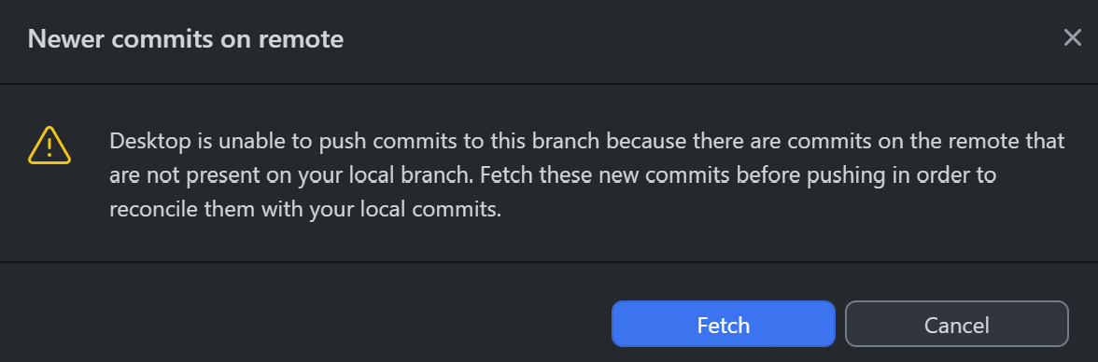
Merge Conflicts 1
This message indicates your changes are on an older version of the repository stored on github. When this happens, first fetch the project.
The simplest way to resolve this is to either use your changes and overwrite the project which might erase someone else's changes
Or to use the project changes
And overwrite your own.
(useful if your change
Is minor)

Slide 17
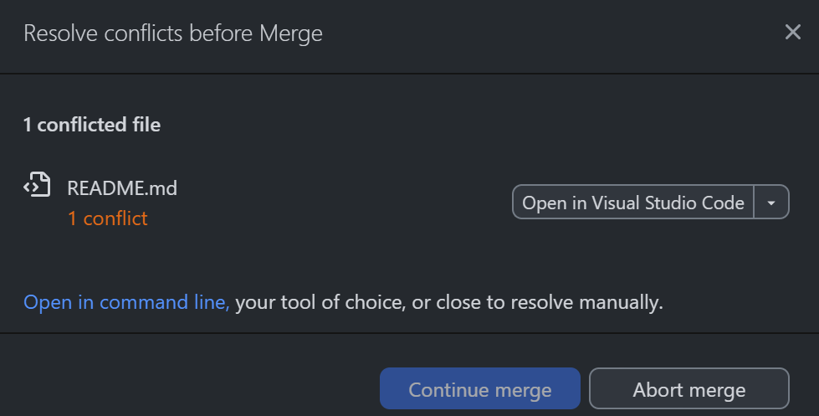
Merge Conflicts 2
In the drop down, to use your local changes choose “use modified version from master”
To use the remote repository choose “use modified version from origin/master”
Note - origin represent the remote repository
If you want to manually decide
Which changes to keep then
Either click open in visual studio code
Or, if comfortable, open in command line

Slide 18
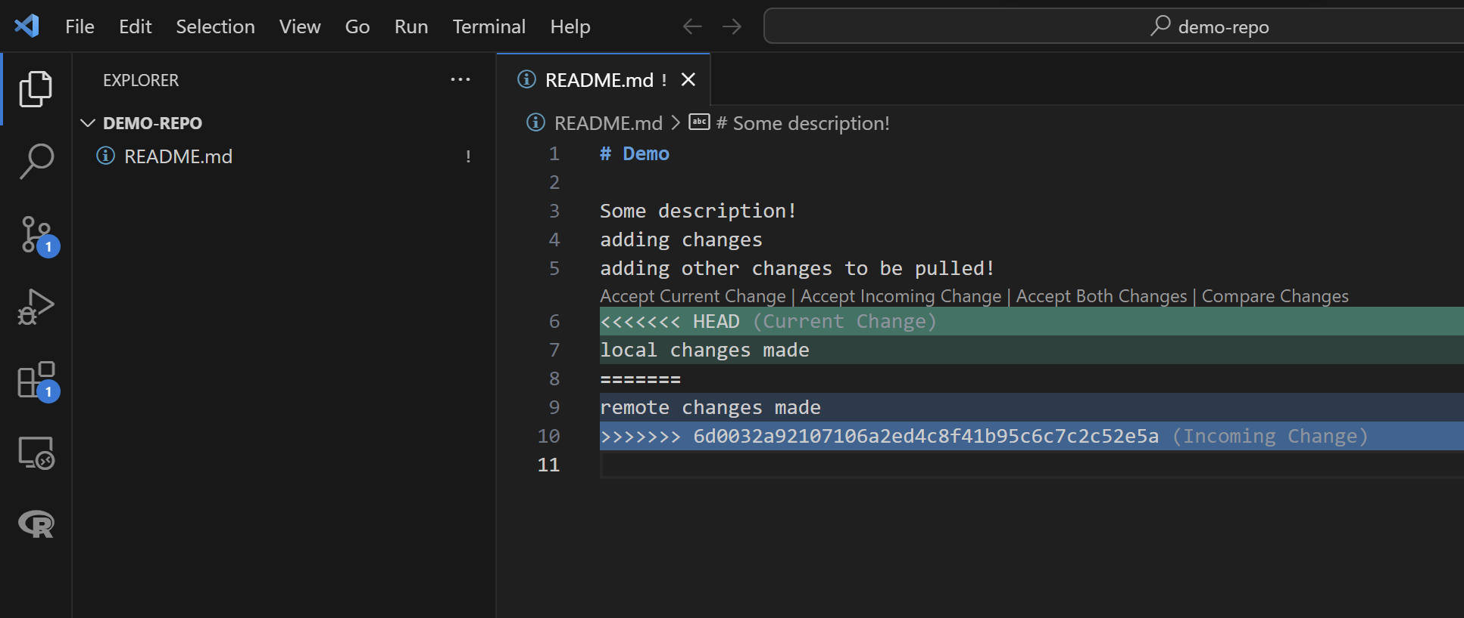
Merge Conflicts 3 (VS Code 1)
In VS Code, there are four different options for each group of changes made.
In this example, there is only one change that conflicts between the local and remote repositories
So, there
Is only one set
Of options

Slide 19
Merge Conflicts 3 (VS Code 2)
Current changes - represents local changes made on your own machine and using only that
Incoming changes - represents changes in the remote repository
Both changes - represents keeping both local changes along with everything in the remote repository
Compare Changes - opens a new file tab in VS Code to show the differences in more detail
See next slide

Slide 20
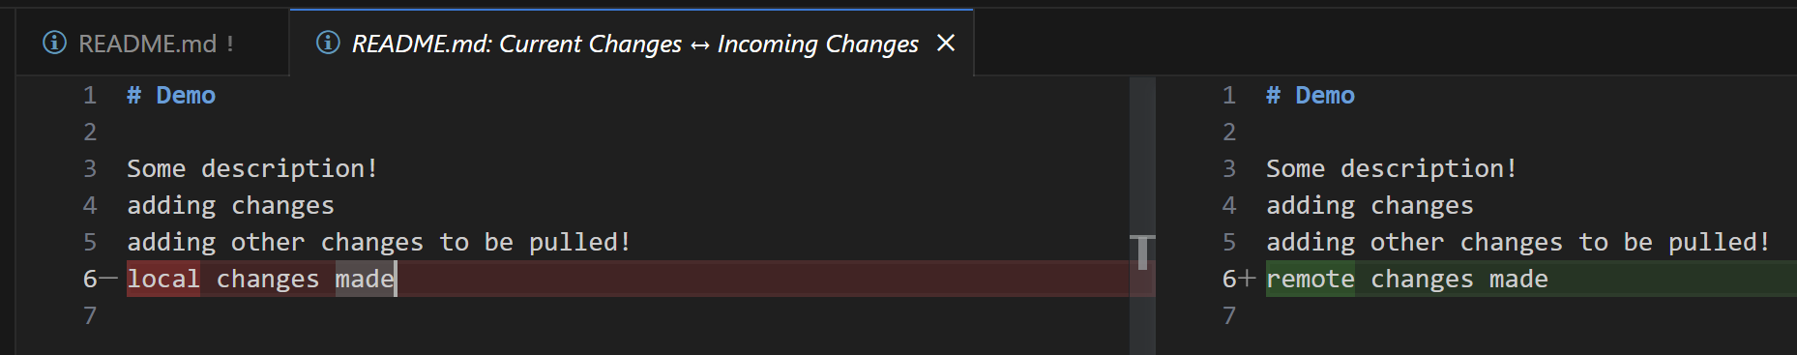
Merge Conflicts 3 (VS Code 3)
Local Changes - highlighted in red
Set on the left side of the window
Remote Changes - highlighted in green
Set on the right side of the window
Move back to the tab with the merge conflict denoted by a ‘!’ next to the name to continue resolving the merge conflict. (in this case, that would be README.md !

Slide 21
Merge Conflicts 3 (VS Code 4)
For each difference with local changes highlighted in green and more recent remote changes highlighted in blue, choose the option that best suits the situation

Slide 22
Git in VSCode (second easiest; still has GUI)

Slide 23
VSCode vs Github Desktop
While using VSCode directly cuts out the middle man of Github Desktop, it may be a bit more confusing compared to using Github Desktop in conjunction with VSCode
Using VSCode could potentially allow the process to be streamlined if you get familiar enough with the process compared to using Github Desktop with VSCode.

Slide 24
Cloning the Repository
First open VSCode
On the Welcome tab, click Clone a Repository (do not click “Clone from Github”)
Go to the repository URL
Click the “Code <>” button
Then click the double square button to copy the HTTPS url
Next, in the textbox in VSCode, paste in the repository URL
Click “clone repository from URL”
Find the folder you want to place the project and click “OK”
I chose: “C:\Users\<username>\OneDrive\Documents\GitHub” where username is the name of the home directory.

Slide 25
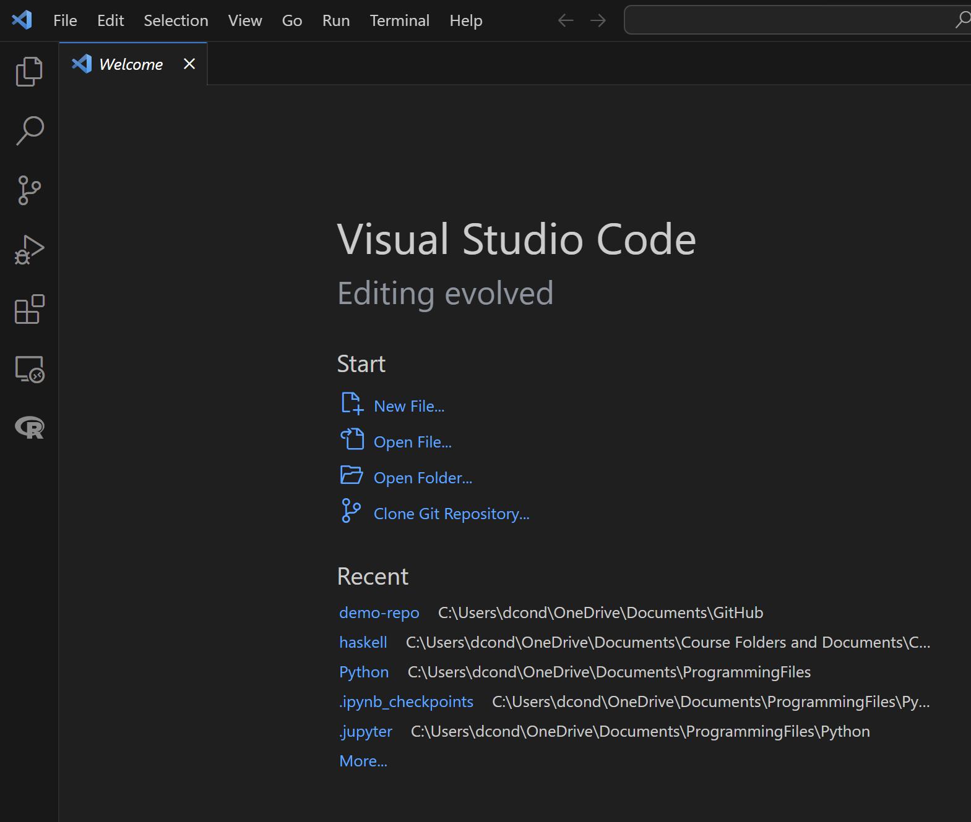
Reopening the Project
If VSCode doesn’t have your project open already reopening the project, then click first icon on the left below the blue VSCode symbol to open what would be the built in VSCode file explorer boxed in red
Then click “Open Folder”
Browse to the folder that is the repository and click “Select Folder”

Slide 26
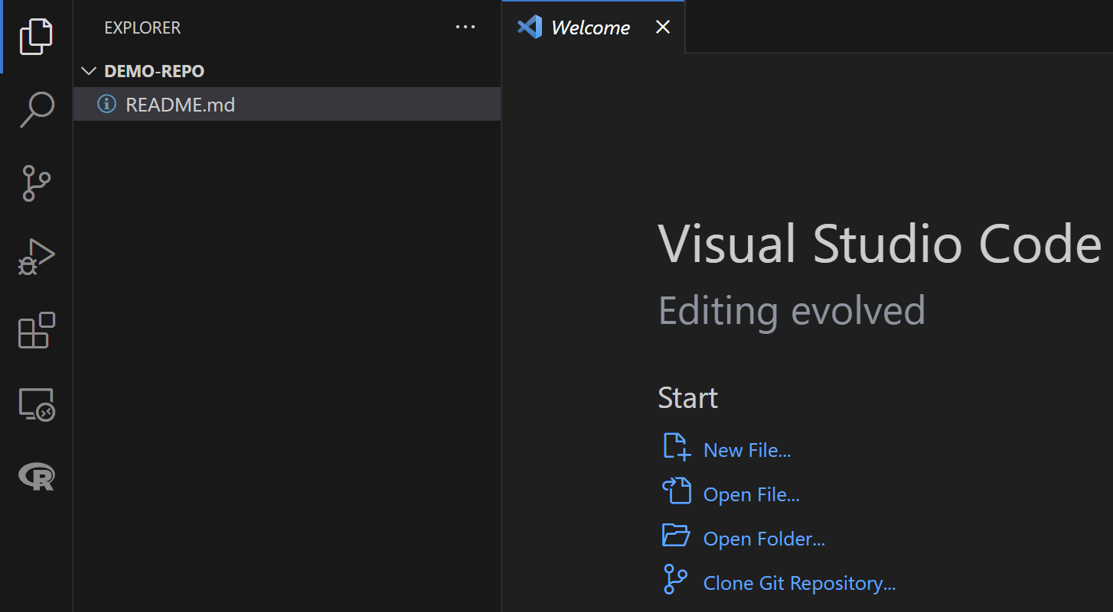
Adding Changes to the Repository 1
In VSCode, navigate the explorer to choose which files you want to edit and make your changes
Note that a white circle next to the file in a tab means that the file has unsaved changes
Go to file -> save or use the shortcut Ctrl + s or turn on autosave by going to file -> autosave to save the file
Then, after saving the files you want to add, click the third icon with the three circles to see the graphical git interface in VSCode. This would be used instead of github desktop or the terminal
Note - a ‘M’ indicates that a file has saved changes or that it is “modified” that are not committed to git

Slide 27
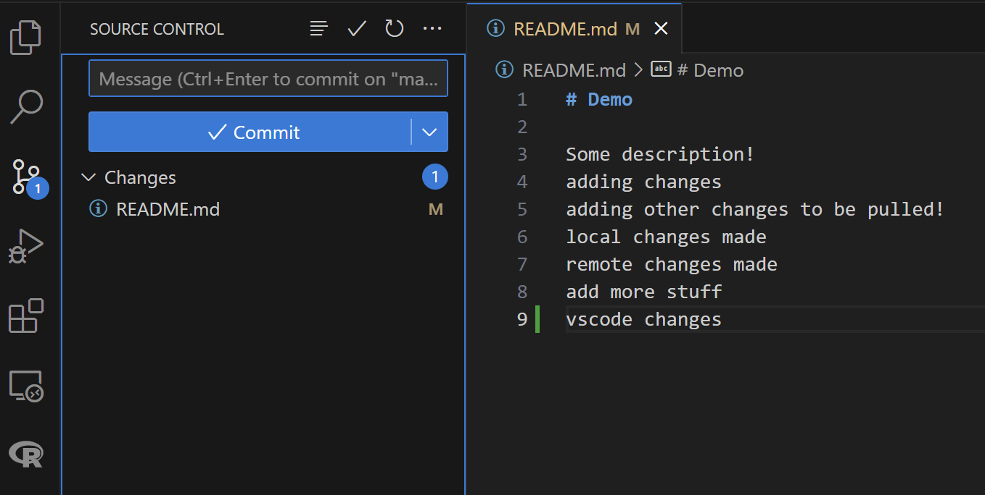
Adding Changes to the Repository 2
After the file is saved, the icon with three circles connected together represents the version control tab in VSCode which can then be used to “stage” and commit changes
Stage - to add changes to a commit. You can choose to exclude files from the commit which is why there is an additional step to stage your changes
To stage files, hover over the file name and click the ‘+’ that appears next to it to add it to a potential commit
Then, add your message to describe the changes you made and click commit. This saves to your local repository in git. Notice the ‘M’ disappears.

Slide 28
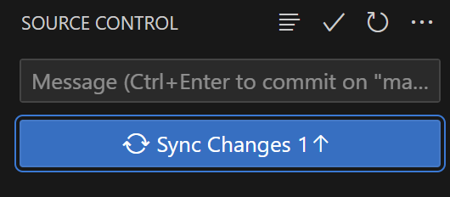
Getting the Most Recent Changes using Pull
Using VSCode, the button “Sync Changes” will pull the most recent
Version of the project and then, if there are no conflicting changes,
Upload your local copy of the repository to the remote on github
If a popup appears asking to use git fetch periodically, that means it is offering to periodically check to make sure that you are running the most recent project version. It is similar to how you can “Check for Updates” on a windows machine to see if there are any available updates. This option would make this happen periodically and automatically. I personally choose no.
If there is a problem uploading to the remote repository on github, then you have a merge conflict

Slide 29
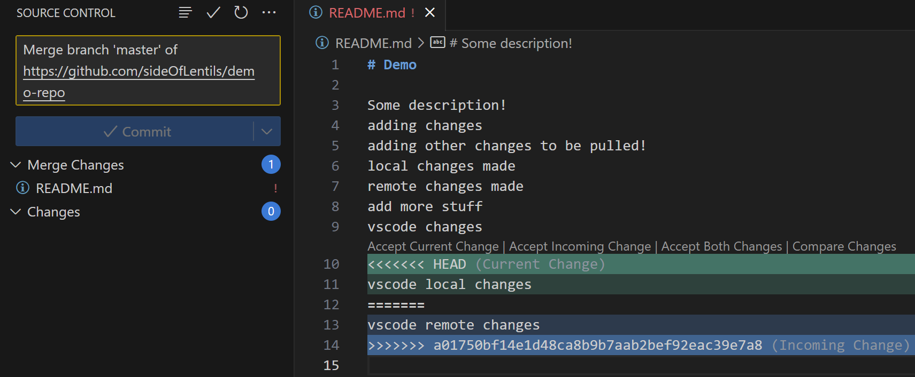
Merge Conflicts
This picture shows how merge conflicts are displayed in VSCode
The ! next to the file name indicates a merge conflict
Green represents current changes (made locally) and blue represents incoming changes (from the remote on github)
After the conflict is resolved,
Stage the change like normal
And commit the result

Slide 30
Merge Conflicts (continued)
The last step is to sync the changes to upload to github

Slide 31
Git in Terminal (hardest to figure out; easiest to use)

Slide 32
Summary

Slide 33
Link to Repository w/ Notes
<ADD REPO LINK TO README HERE>

